Slide 1
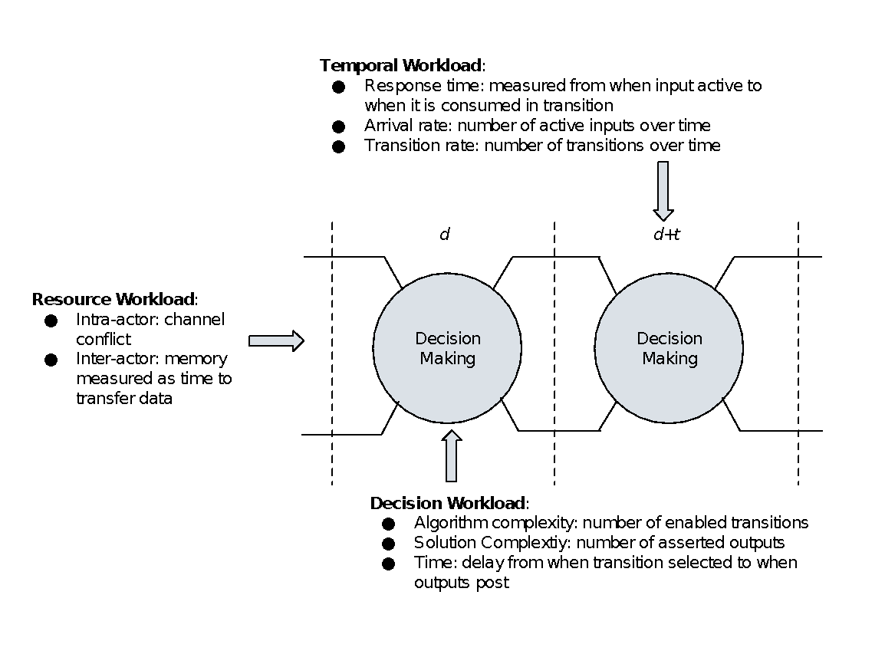
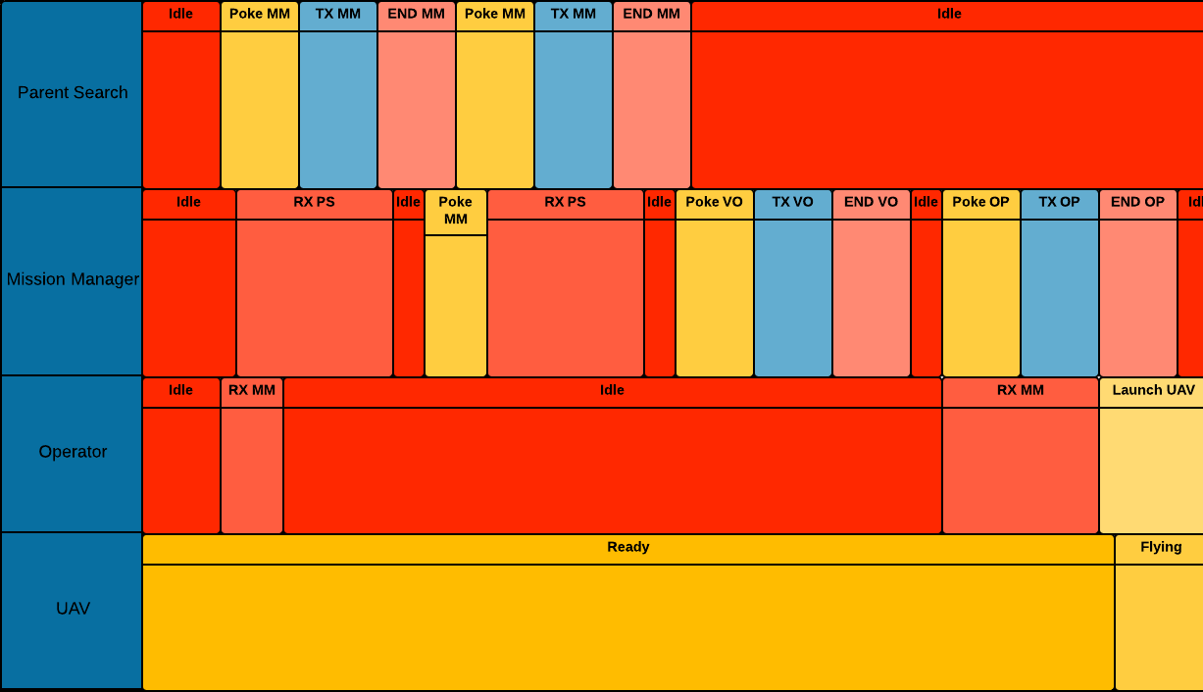
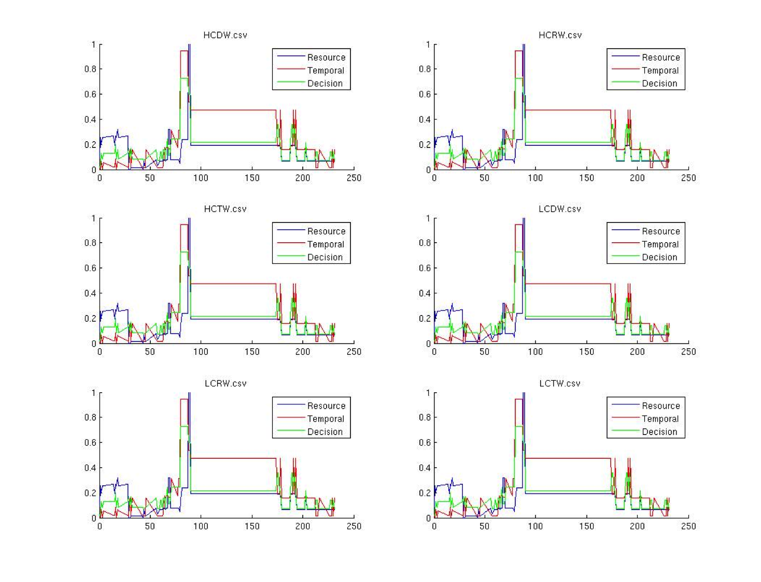
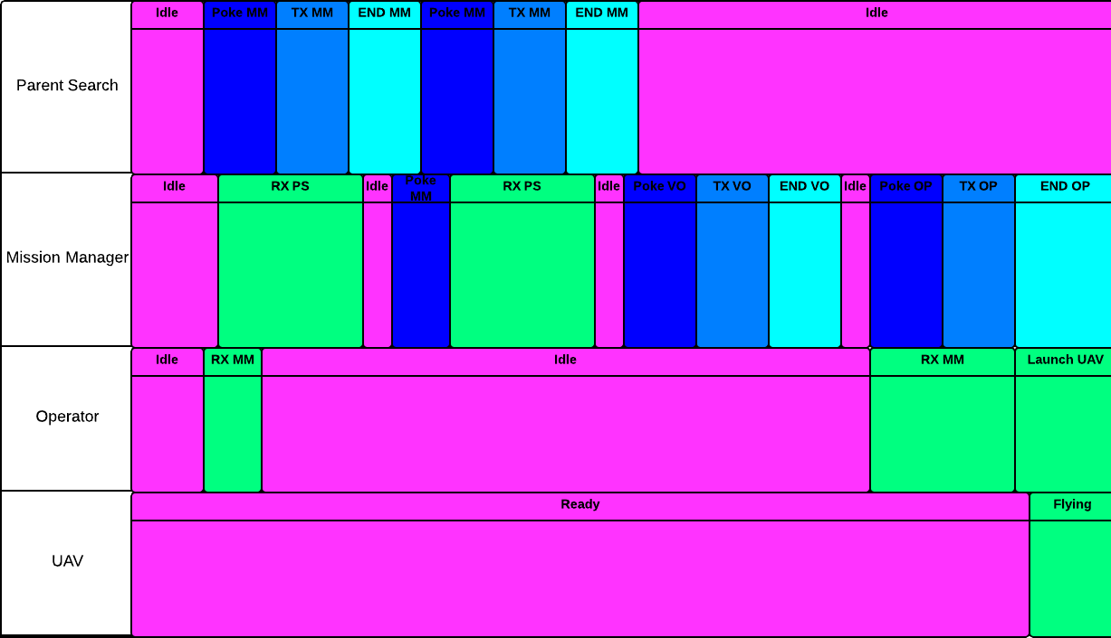
Modeling Workload
Dr. Eric Mercer, Dr. Michael Goodrich, Robert Ivie, Jared Moore
Metrics
Models
Simulator
Temporal Workload
Many Models
Parent Search
Resource Workload
Mission Manager
Operator
Video Operator
Operator GUI
Video Operator GUI
Java Pathfinder
Decision Workload
UAV
Non-Deterministic Model
Swim Lanes
Results

